Slide 1

2026 Zoning Reform
Back to our Roots
Wesleyville.gov
Simplifying the process of development in the Borough

Slide 2
Outline - Context
Borough's Built History
Purpose of Community Planning
Mission of Zoning Reform
Review Zoning Reform
District Adjustments
Parking Requirements
Development Standards
Other Misc. Changes

Slide 3
Borough's Built History
Wesleyville.gov

Slide 4
Built History
Established as a community in the early 1800s.
Our oldest currently standing house was built in 1820 (1909 Center St). At that time, it was a designated village within the township of harborcreek.
Incorporated as a Borough in 1912
Most of the lots in the Borough were cleared subdivided and roads and right of ways established in the 1900s (Especially ~1920-1950)

Slide 5
Built History
1st Phase of Development
Everything built 1800s – 1940s
Largely unregulated and unrestricted, modern zoning and building codes did not exist

Slide 6
Built History
Borough's First Comprehensive Zoning
Passed in the 1950s
More restrictive than what existed prior. It made stricter some development standards that had prior to that been a normal part of the character of the community.
But overall, it set a development standard and did not fully disallow substantial development because many structures in the Borough were built between the 1950s-1970s.

Slide 7
Built History
The Zoning that Broke Us – The Current Zoning we live under
In 1989, as a bunch of communities around us were adopting new, more restrictive Zoning regulations, our Borough worked with an outside consulting firm who wrote us up a cookie-cutter zoning ordinance. This was unfortunately not fitting for a small, tightknit community like ours that did not have a large supply of land.
The zoning was so restrictive that it made illegal a majority of the Borough's existing structures in one way or another.
It completely stunted our growth.
Since then little to no new development has occurred. Decades without anything.

Slide 8
Built History
The Zoning that Broke Us – The Current Zoning we live under
What is the problem with the current zoning?
It's needlessly confusing in many aspects.
It regulates aspects of development that it doesn't need to. Ex. Things the Borough's other adopted codes take care of already
It is too restrictive and completely out of alignment with the existing built environment of the Borough.
It disallowed most forms of development, and then nothing was developed.
It's had its time - over 30 years on our books. It's done enough damage, time for reform

Slide 9
Community Planning
Wesleyville.gov

Slide 10
Community Planning
When planning a community we need to think of the community in its parts.
Public Domains - the areas that have been set aside for the good of the public, think of the streets and the parks.
Private Domains, the areas that are subdivided out of the remaining areas not designated as public domain. These are divided with property lines to create individual parcels.

Slide 11
Community Planning
Public Domain - Public rights of ways, think of the streets that allow for freedom of mobility to and from every parcel.
Generally, it could be assumed that the right of way present is more than enough needed to serve the public good.

Slide 12
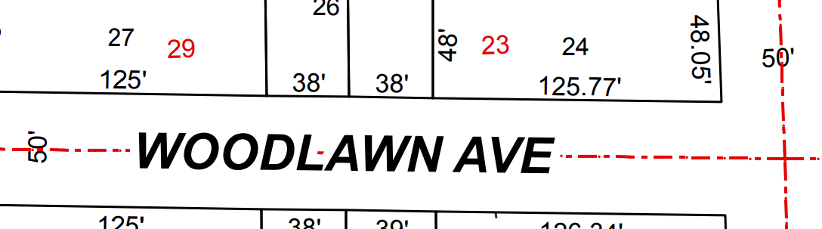
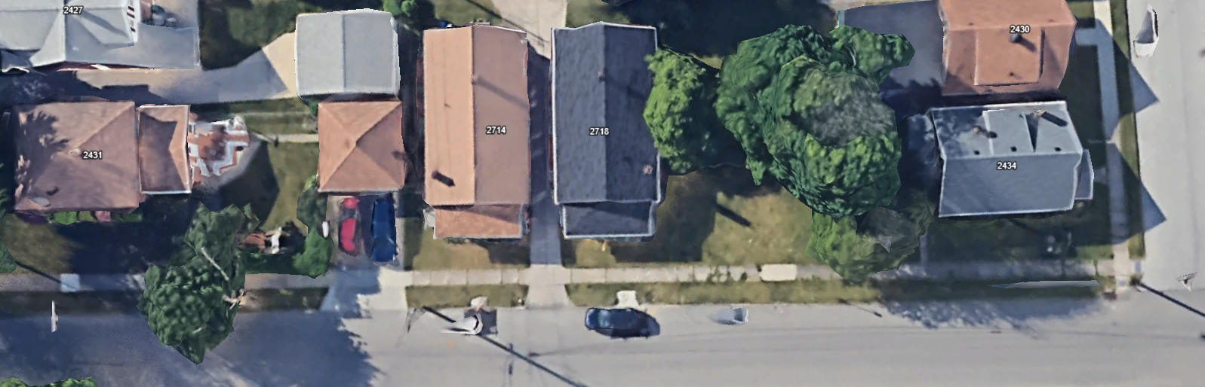
Community Planning
Public Domains – Rights of Way
Ex. Woodlawn Ave by Union Ave intersection.
Both Woodlawn and Union have a 50' Right of Way

Slide 13
Community Planning
Public Domains – Rights of Way
At this particular spot, Woodlawn Ave's paved street is 26ft wide, and Union Ave's paved street is 30ft wide.
Meaning, the Borough has more Right of Way than it ends up using for the roads and the additional is a built-in cushion that accounts for sidewalks and other stormwater needs. This right of way arrangement is generally applicable across the Borough.

Slide 14
Community Planning
Private Domain – Areas not deemed necessary to hold in the public domain
To protect the surrounding properties, the Borough may choose to regulate certain land uses and impose standards of development.
However, it must be remembered, the regulations shouldn't be overbearing or unnecessarily specific, or arbitrary.
It's not supposed to impose a demand onto a person looking to develop unless there is a clear problem to be solved.
It needs to be strict enough to functionally protect the public good and lenient enough to allow for future development

Slide 15
Community Planning
Private Domain
Also, it is important to remember that Zoning regulations are meant to define the boundaries of the most extreme developments allowed.
With a vast majority of the development to occur, people will choose to self-enforce even stricter standards than those outlined because they personally don’t want to have their structures too close to the street, or to the neighboring properties.
Most people won’t use their properties to the 100% max defined capacity.
Example: the code may allow someone to put their shed as near to the property line as 4 feet but they may still choose 6 feet so they can easily mow and maintain the side.

Slide 16
2026 Reform
Wesleyville.gov

Slide 17
Mission of Zoning Adjustment
Mission – Adopt a simple, effective zoning ordinance that adequately protects neighboring properties while also encouraging continued development.
Our 2026 Zoning Ordinance should;
Be guided by our lovely built history on the ground and the initial 1950s zoning code.
Only regulate if there is a clear problem to solve.

Slide 18
2026 Zoning
Resources used to craft the 2026 Zoning Adjustments as proposed
Real-world built examples
Borough 1950s Zoning Ordinance
Borough 1980s Zoning Ordinance
Erie County Tax Plat Maps

Slide 19
2026 Zoning
District Adjustments
Simplify Residential
Rename Industrial
Reduce Parking Requirements for Business District
Loosen Required Development Standards (Table/Application)
Misc. Non-Controversial/Material
Moved Permanent Foundation Section
Renamed "Several-Family Dwellings" section to "Right to convert single family into expanded residential use"

Slide 20
District Adjustments
Wesleyville.gov

Slide 21
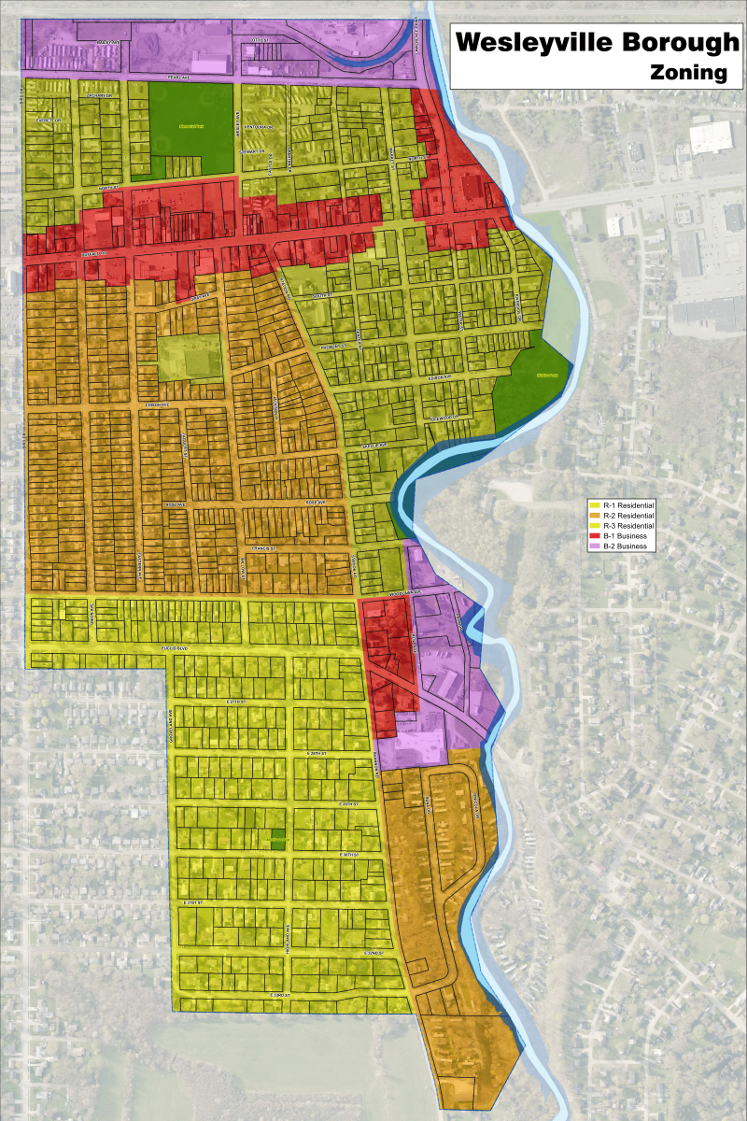
Simplify Districts
Current District Structure
R1 & R2 & R3
B1 & B2

Slide 22
Simplify Districts
Simplify into only 2 residential districts.
Everything currently zoning R-2 & R-3 would be combined.
You've got WLV "Downtown" and "College Heights"

Slide 23
Simplify Districts
R-1 would be College Heights,
Merged R-2 would include all areas of the Borough that are currently R-2 and R-3.
Current R2 & R3 already allow mobile home parks
Current R2 & R3 both have multifamily homes in operation and R2 already allows single family to be converted to a multi-family.
R3 is slightly more relaxed on yard requirements, a few feet less here or there.

Slide 24
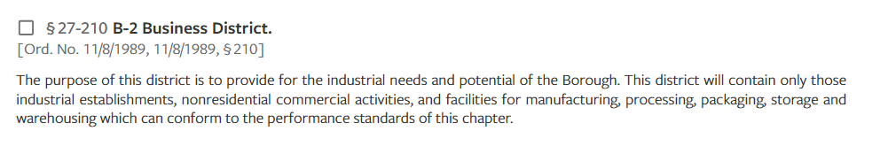
Simplify Districts
Rename B-2 Business to I-1 Industrial

Slide 25
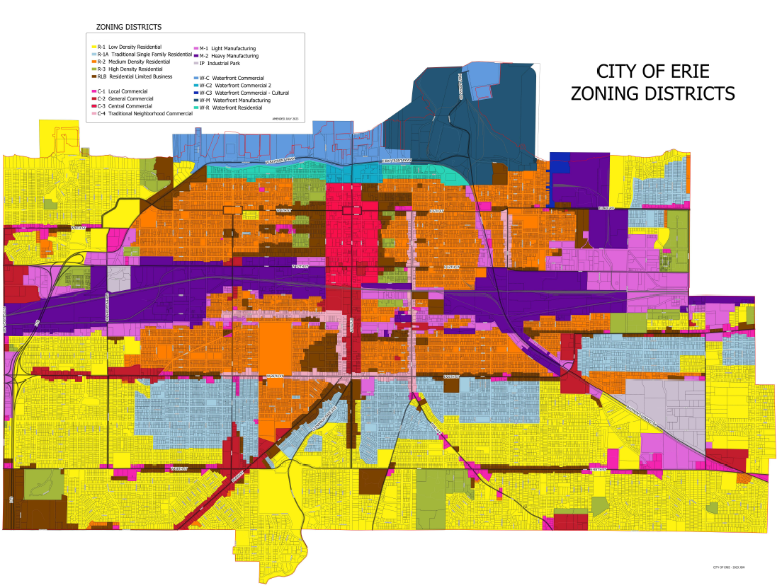
Simplify Districts
5 Residential Types
4 Commercial
3 Industrial
+ Waterfront types

Slide 26
Parking Requirements
Wesleyville.gov

Slide 27
Parking Requirements
Regulates how much parking is required for various types of development
1st Phase of Borough Development
No established parking requirement
Borough 1950s Zoning
No established parking requirement

Slide 28
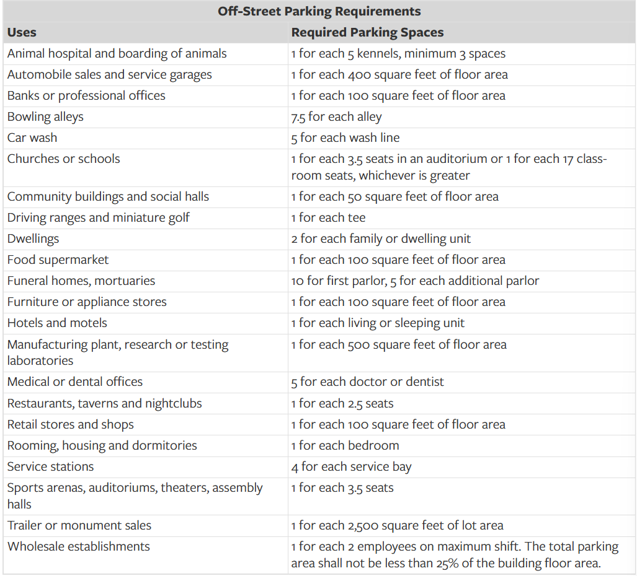
Parking Requirements
Borough 1980s Restrictive Zoning
Too specific and too radical

Slide 29
Parking Requirements
Borough 1980s Restrictive Zoning
An off-street parking space is defined as, at minimum, a 9ft x 18ft spot, or 162 sq ft.
So according to the previous chart, a food market, retail shop, and/or appliance shop is required to provide dedicated off-street parking at one 162 sq ft parking spot for each 100 sq ft inside area.
Questions to ponder;
Why are these categories and spot counts defined this way? Largely arbitrary.
Would we ever really say no to a business because it doesn't provide enough parking to be adequate according to the 1980s consultants?

Slide 30
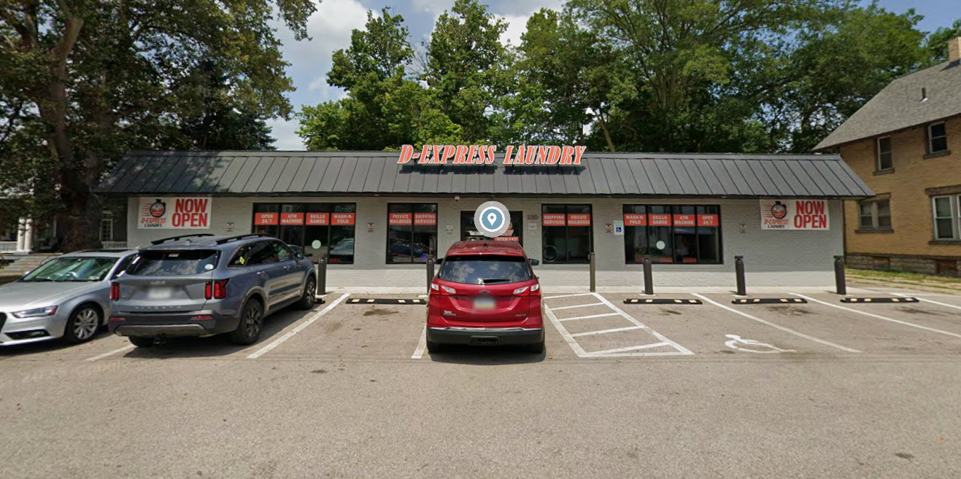
Parking Requirements
D-Express Laundry by Buffalo/Station Intersection
Square footage according to the county ~3,500sqft
Opened about 2023.
If we fully enforced our ordinance, they wouldn't have been allowed to operate without 35 SPOTS!

Slide 31
Parking Requirements
D-Express Laundry by Buffalo/Station Intersection
This was before my time, however it is an example of a business we did not prevent from opening despite them not being able to meet the ludicrous parking requirements

Slide 32
Parking Requirements
And it is an example of how, despite the parking requirements not being met, the real-world experience hasn't been negative.
The public has not been impacted by them only having about 10 spots.
D-Express Laundry by Buffalo/Station Intersection

Slide 33
Parking Requirements
2026 Zoning Adjustment
Eliminate Parking Requirements in Most Cases
Allow for the business owners to dictate their parking needs for themselves.
In the case of residential, impose a reasonable minimum simply to ensure that parking doesn't become too limited in our residential zones.
Simple parking requirement - Minimum space(s) per dwelling unit.
The 1980s Zoning currently sets this at 2 spots per dwelling. This could be maintained or dropped to 1 spot per dwelling unit.

Slide 34
Development Standards
Lot Specs
Yard Requirements
Structure Allowances
Wesleyville.gov

Slide 35
Standards – Lot Specs
Wesleyville.gov

Slide 36
Lot Specs
Minimum Lot Area
Purpose:
Prevent a bunch of tiny, useless parcels in the Borough.
Create some limit for how many units can fit on one parcel

Slide 37
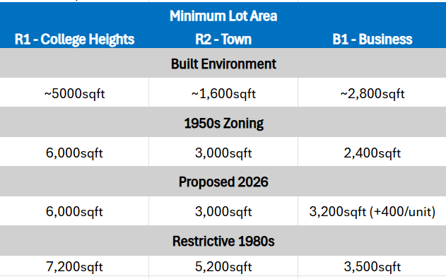
Lot Specs

Slide 38
Lot Specs
Minimum Lot Width
Purpose:
To ensure each lot within the Borough has access to a public right of way for a reasonable, minimum amount.

Slide 39
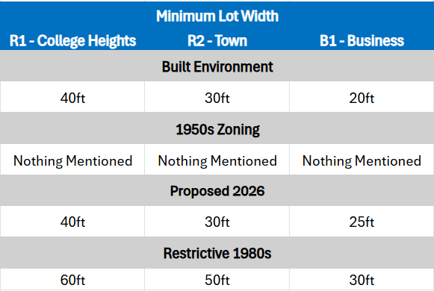
Lot Specs

Slide 40
Standards – Yards
Wesleyville.gov

Slide 41
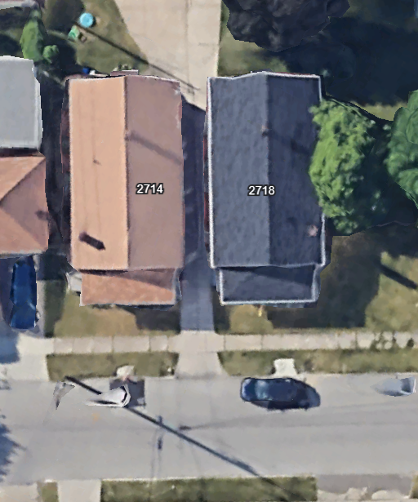
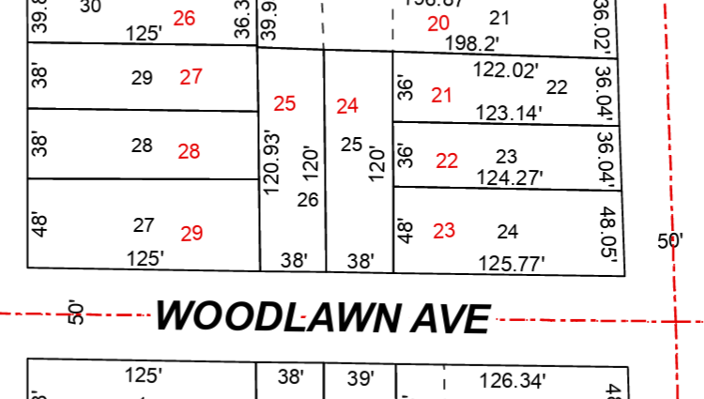
Yards Requirements
How are yard requirements measured in the real world?
"Yard setback depths shall be measured from the edge of the street right-of-way and/or the adjoining property line."

Slide 42
Yards Requirements
Lot Specs – 38 x 120
38ft wide, minimum amount of right of way frontage.
120ft depth
4,560sqft lot - "Lot Area"
Right of ways.
Woodlawn Right-of-Way – 50ft
Woodlawn Ave - Street Width – 26ft

Slide 43
Yards Requirements
Yard Requirements
Front Yard – measured from the edge of the right of way. Typically easily identifiable from the presence of the sidewalk.
Side Yard
Measured from the neighboring property line on both sides
Built environment – often uneven to accommodate driveway

Slide 44
Yards Requirements
Yard Requirements
Rear Yards - Backyards
Note – It's pretty unreasonable for the local government to require both a large front yard and a large rear yard.

Slide 45
Yards Requirements
This section will look district by district at each type of yard requirement and compare the
Borough's built history,
the 1950s zoning,
the recommended 2026 zoning,
and the current 1980s zoning.
Note – For the most part, I am recommending that the Borough return to the level of the 1950s zoning, however in some key categories I recommend returning to a standard based on built examples and not the Borough's initial zoning attempt.

Slide 46
Yards for Business District
1st Phase of Borough Development
It was commonplace for little to no yard requirements to be present when constructed.
Think of the 1900s – 1940s Main street structures such as Yurkovic Plumbing, Terry Etzel's, JDL Computer, etc.

Slide 47
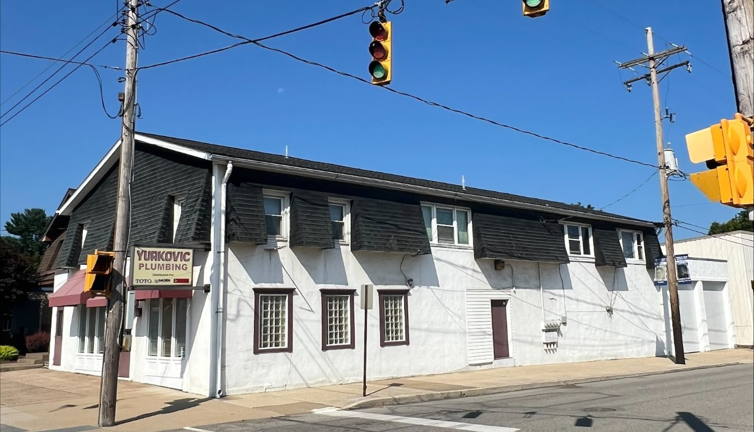
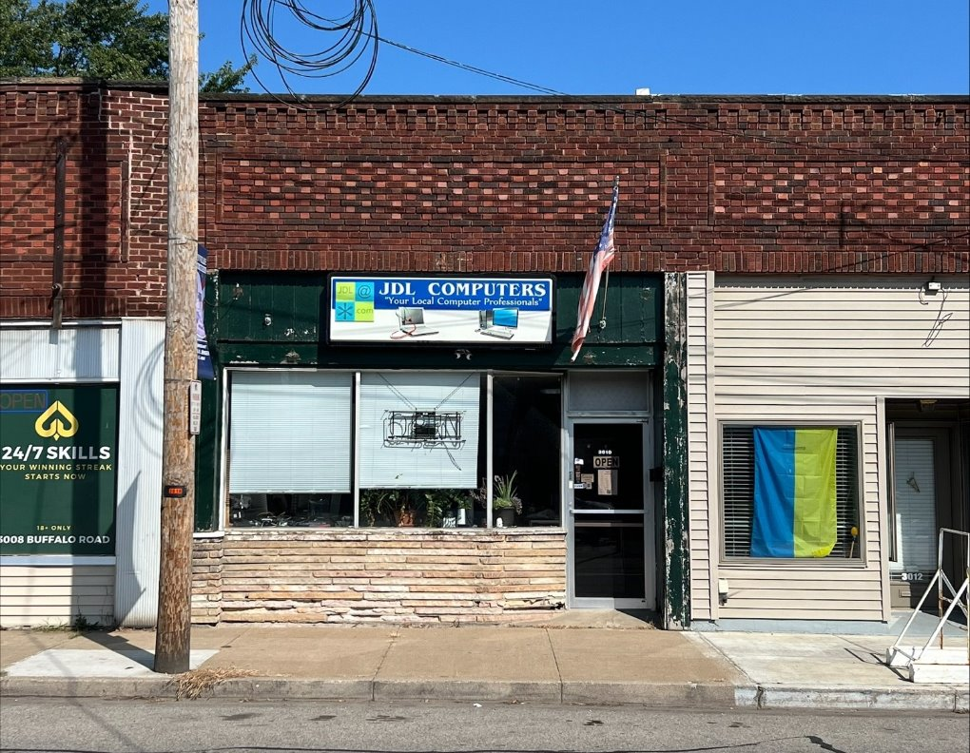
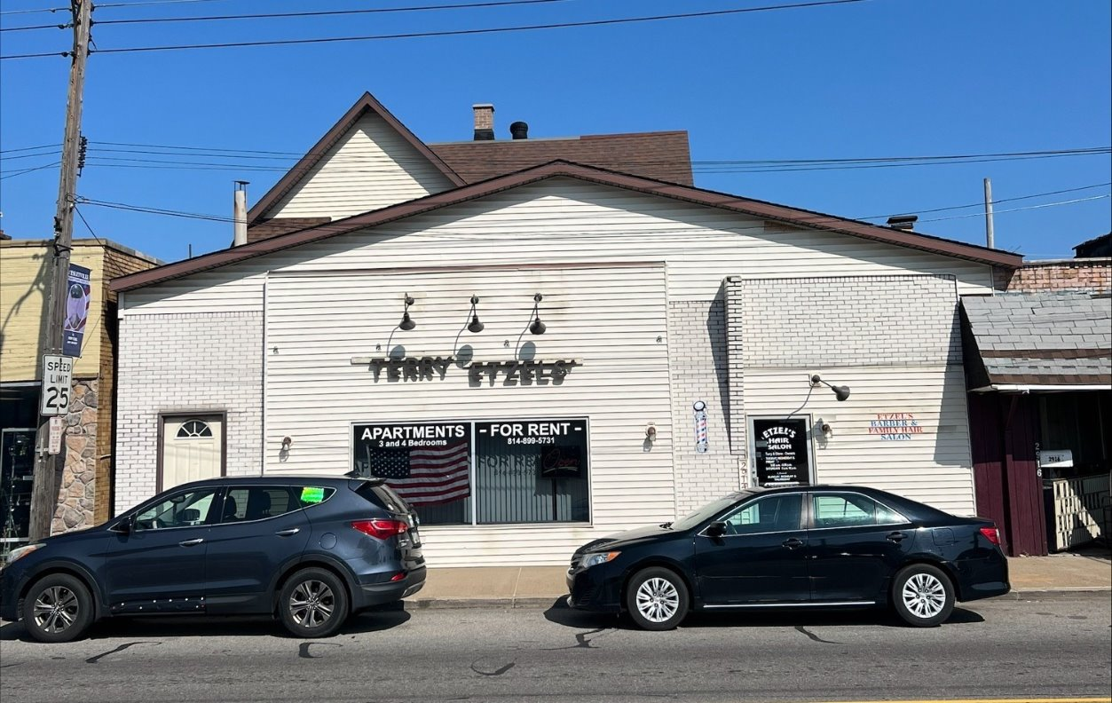
Yards for Business District

Slide 48
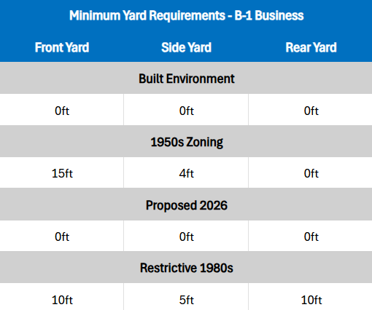
Yards for Business District

Slide 49
Yards for Business District
Exceptions;
Minimum yard setback of 10ft for parcels abutting residential parcels
If a structure already exists on the property line, the minimum automatically reverts to 5ft setback.

Slide 50
Yards for Business District
The 1980s Zoning requiring a 10ft front and 5ft side setbacks doesn't sound like much, but.
Might not sound like a lot, but some of the parcels on Buffalo Road are 30ft, a 5ft required setback on both sides results in 10ft or unused frontage.
10ft/30ft = 33% of wasted space.

Slide 51
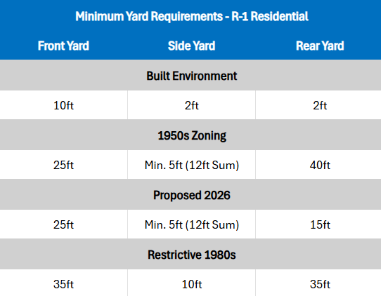
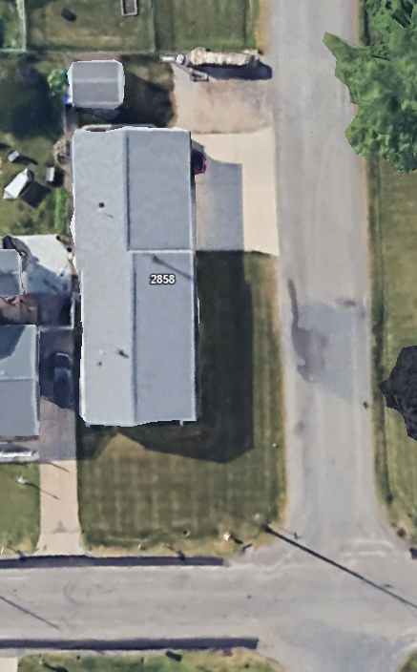
Yards for R-1 – College Heights

Slide 52
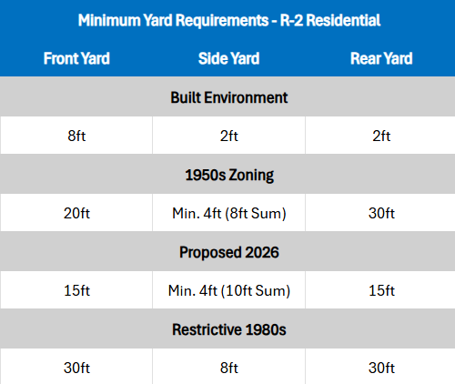
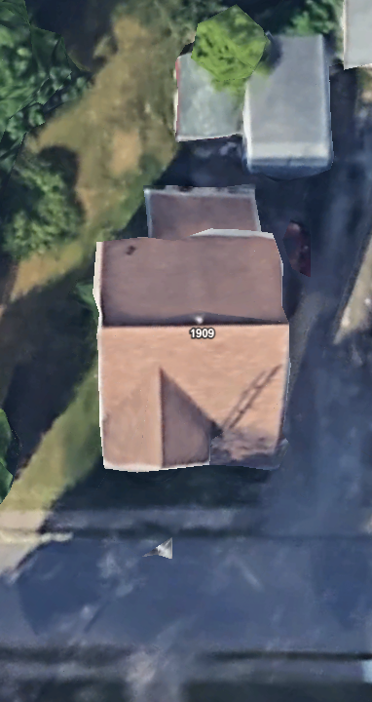
Yards for R-2 – In Town

Slide 53
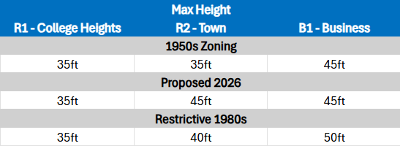
Max Structure Allowances

Slide 54
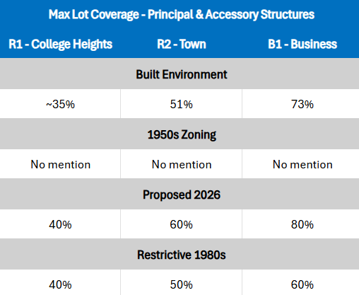
Max Structure Allowances

Slide 55
Application of Standards
Substantive Changes -
Alignment with Historical Setbacks – Allowing for Zoning Officer Reductions
Exists in the 1950s and 1980s Zoning – Expand the definition to include all yard setbacks and to better define the reference area.
This provision is intended to support consistency with established development patterns and streetscapes.
Elimination of minimum unit size within Zoning – health and safety is taken care of in the PA building codes.
Side yard setbacks can be eliminated when built simultaneously. Townhomes!

Slide 56
Yards Requirements
Illegal to build under the 1980s Restrictive Zoning
Lot is 640 sqft too small for a single-family detached structure.
Lot is 12ft too narrow
Front yard is 20ft too short
Side yards are a combined 8ft too narrow.
Both have Zestimates between $107k - $117k. The market has spoken.

Slide 57
Yards Requirements
Legal to build under the 2026 Zoning
Homes like the ones built in the 1920s could be built again.
In this case, the only differences would be:
New PA Building codes
5ft further back from the road.
2 required off street parking spots each unit.

Slide 58
Other Misc. Non-Material Changes
Wesleyville.gov

Slide 59
Other Misc. Changes
Giving dedicated section to the requirement for a permanent foundation:
Already existing in Ordinance but it is completely buried in the application of yard requirements sections.
Not logical, not easy to find administratively, should be a standalone sections.
Renaming 27-407 “Several-family dwellings” to “Right to convert single family into expanded residential use”

Slide 60
Summary
Wesleyville.gov

Slide 61
Process Ahead
First Public Hearing – Feb 11th, 2026
Awaiting feedback from:
County Planning Dept.
PA State Community Planning Experts
2nd hearing may be required if any substantial changes arise.
Final passage possible at 2nd meeting of February or the 1st of March, depending on the need for a second showing.

Slide 62
Learn More
Wesleyville.gov/2026Zoning
There you'll find -
Copies of this presentation,
The Borough's Current 1980s Zoning
The Borough's Historical 1950s Zoning
Copies of the draft 2026 Zoning Adjustment Ordinance

